Slide 1
SHARMILA R
FINAL PROJECT

Slide 2
Drug Discovery
Drug discovery is a complex and resource-intensive process aimed at identifying new therapeutic compounds to treat diseases. Traditional drug discovery involves screening large libraries of molecules, synthesizing and testing them for efficacy and safety, a process that can take years and costs billions of dollars. However, with advancements in artificial intelligence, particularly generative AI, the landscape of drug discovery is rapidly evolving.
Generative AI refers to algorithms that can generate new data samples, such as images, text, or molecules, based on patterns learned from existing data. In the context of drug discovery, generative AI techniques are used to design novel molecules with desired properties, such as efficacy and safety profiles.

Slide 3
AGENDA
PROBLEM STATEMENT
PROJECT OVERVIEW
WHO ARE THE END USERS?
YOUR SOLUTION AND ITS VALUE PROPOSITION
THE WOW IN YOUR SOLUTION
MODELLING
RESULTS

Slide 4
PROBLEM STATEMENT
Data Fragmentation:
Despite the abundance of data in drug discovery, it is often fragmented across various sources, including research institutions, pharmaceutical companies, and public databases.
Lack of standardized formats and interoperability hinders efficient data sharing and integration, leading to inefficiencies and missed opportunities for collaboration.
Data Quality and Completeness:
Ensuring the quality and completeness of data is a significant challenge in drug discovery.
Inconsistencies, errors, and missing information in datasets can impede the accuracy of analyses and hinder the discovery of novel drug candidates.
Limited Accessibility:
Access to high-quality data is often restricted due to proprietary concerns, licensing agreements, and data privacy regulations.
This limited accessibility prevents researchers from fully leveraging available data and collaborating effectively to accelerate drug discovery efforts.

Slide 5
PROJECT OVERVIEW
Here we will search for approved drugs for novel applications, which is sometimes referred to as drug repurposing. This is an important aspect of drug discovery because it reduces the time and resources required to deliver a treatment to a patient in need. By using drugs that are already approved, this approach eliminates phase I of clinical trials which proves the drug is safe for human use. This is especially important in the realm of rare diseases that have been overlooked by drug funding due to lack of projected profit caused by the small market pool. This reuse of approved compounds allows researchers to find treatments for those with rare disease with less upfront cost for companies to fund.
The first aspect of drug discovery is to identify candidate compounds from a pool of human approved drugs to be used in a novel application or disease treatment. The Data Commons Biomedical Knowledge Graph (DC KG) is an ideal asset in drug discovery because it resolves many sources of compound and disease related data into one entity, ready to be queried. This notebook will focus on this computational aspect of drug discovery by analyzing drug-gene and disease-gene associations from Data Commons in order to suggest candidate molecules for treatment of a given disease.

Slide 6
WHO ARE THE END USERS?
Pharmaceutical Companies
Biotechnology Companies
Academic Researchers
Contract Research Organizations (CROs)
Healthcare Providers
Patients

Slide 7
YOUR SOLUTION AND ITS VALUE PROPOSITION
Accelerated Drug Discovery: Generative AI enables the rapid generation and optimization of molecular structures, significantly speeding up the drug discovery process compared to traditional methods. This acceleration can lead to faster identification of potential drug candidates, ultimately reducing time and costs associated with bringing new drugs to market.
Novelty and Diversity: Generative AI algorithms have the capability to explore vast chemical space, generating diverse and novel molecular structures that may not have been previously considered. This increases the likelihood of discovering unique drug candidates with innovative mechanisms of action, addressing unmet medical needs and expanding treatment options for various diseases.
Cost Efficiency: The ability of generative AI to predict and prioritize potential drug candidates based on computational simulations reduces the need for expensive and time-consuming laboratory experiments. This cost efficiency makes drug discovery more accessible to academic researchers, small biotech companies, and pharmaceutical firms, fostering innovation and collaboration within the industry.

Slide 8
THE WOW IN YOUR SOLUTION
High Efficiency Screening Techniques: Developing cutting-edge screening methods that allow for rapid and accurate evaluation of large compound libraries, leading to the discovery of potent drug candidates more efficiently.
Advanced Computational Approaches: Utilizing AI and machine learning algorithms to predict drug-target interactions, optimize drug design, or analyze complex biological data sets, accelerating the drug discovery process.
Precision Medicine: Tailoring therapies to individual patients based on genetic, environmental, and lifestyle factors, thereby maximizing efficacy and minimizing adverse effects.
Multi-Target Therapies: Designing drugs that simultaneously target multiple pathways or molecules involved in disease pathogenesis, offering superior efficacy and reduced likelihood of resistance development.
Platform Technologies: Developing versatile platforms or technologies that can be applied across various therapeutic areas, streamlining the drug discovery pipeline and fostering innovation.
Drug Repurposing: Identifying new therapeutic uses for existing drugs or compounds, offering a faster and more cost-effective route to clinical application.

Slide 9
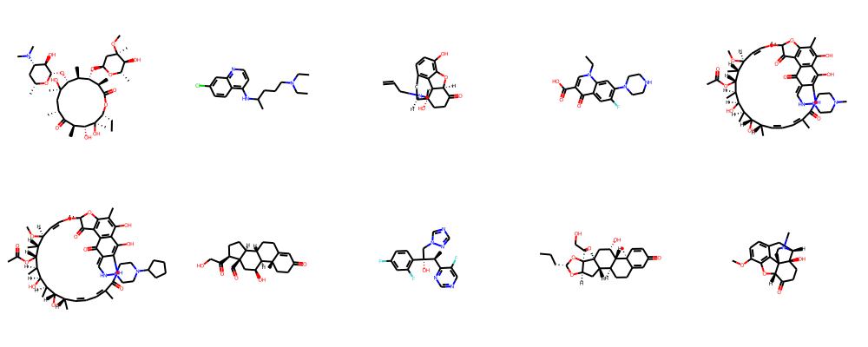
MODELLING
Structure-Based Drug Design: Structure-based drug design involves the use of computational models to predict the three-dimensional structure of target proteins and their interactions with potential drug molecules. Techniques such as molecular docking and molecular dynamics simulations are used to explore the binding affinity and stability of drug-protein complexes, aiding in the design of optimized drug candidates.

Slide 10
RESULTS
Generative AI offers promising avenues in drug discovery by efficiently exploring vast chemical space, predicting molecular structures, and accelerating lead optimization. Through sophisticated algorithms and data-driven approaches, it streamlines the identification of potential drug candidates, reducing time and costs associated with traditional methods. However, successful integration requires robust validation, ethical considerations, and collaboration with domain experts to ensure safety and efficacy. Despite challenges, the synergy of generative AI with traditional methodologies holds immense potential in revolutionizing drug discovery, offering new treatments for various diseases and improving global healthcare outcomes.

